Slide 1
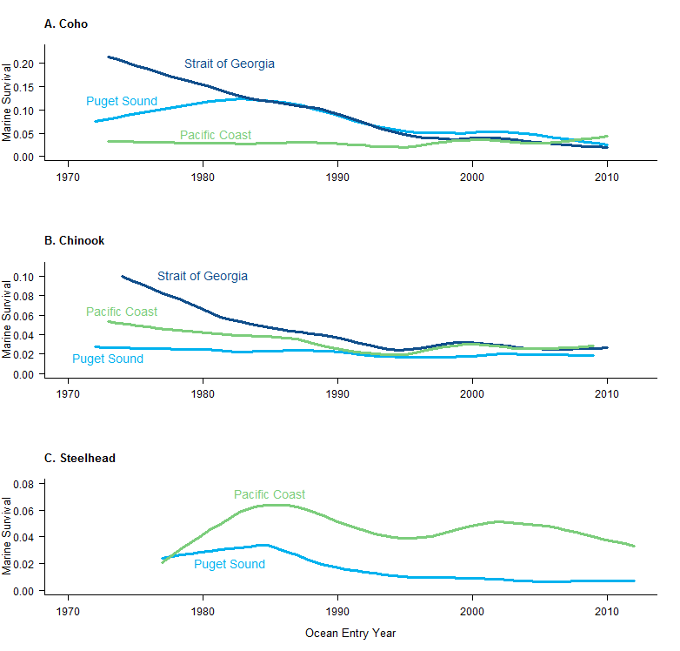
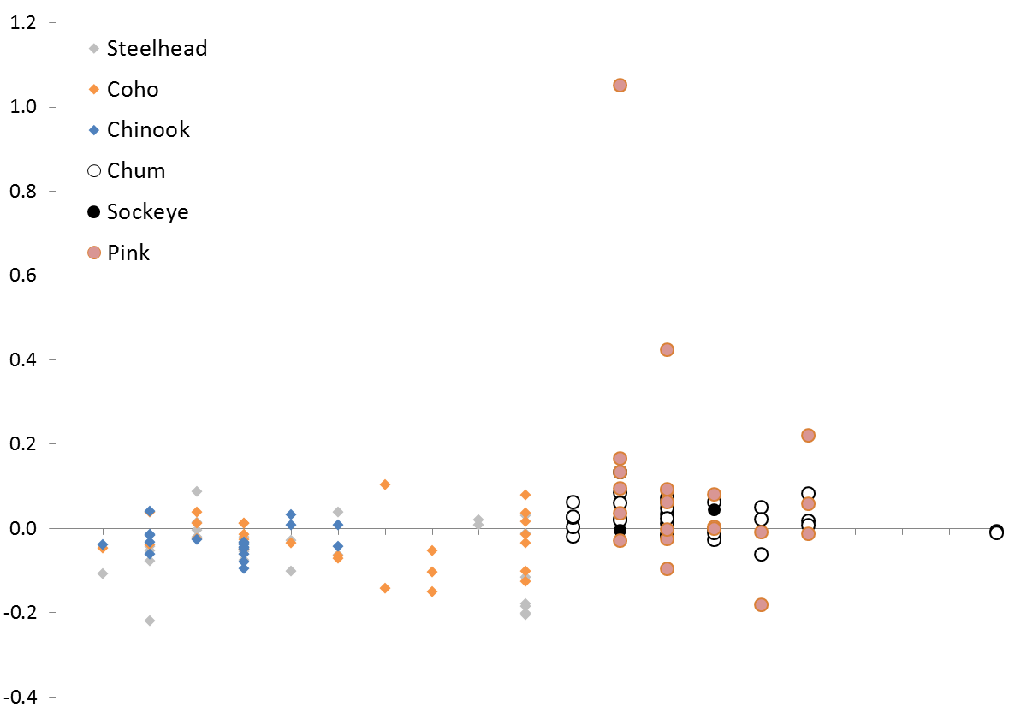
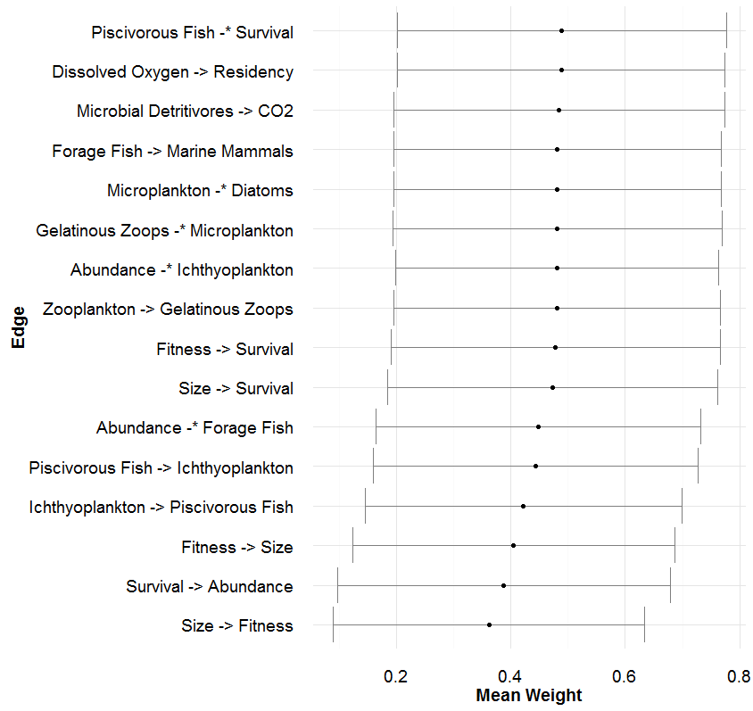
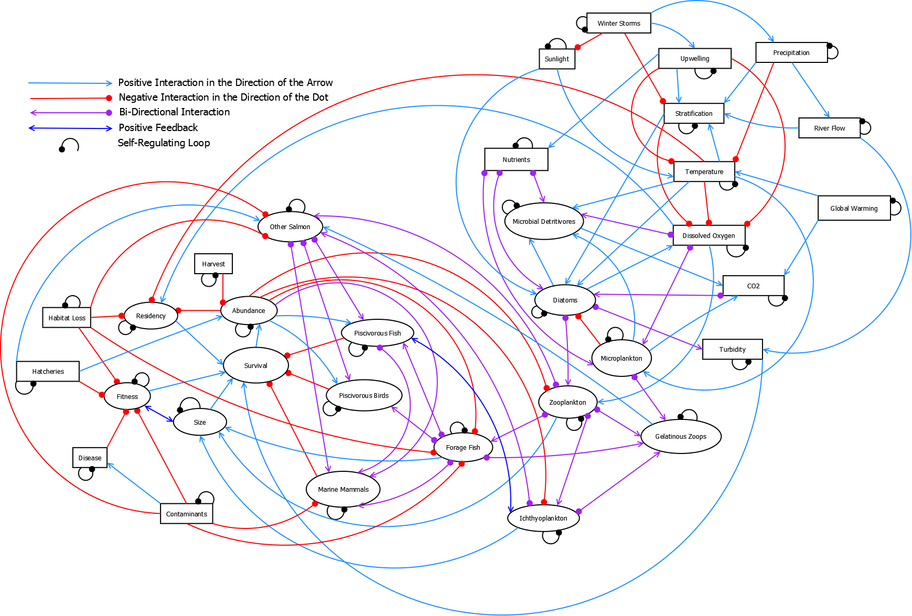


Exploring Drivers in Declining Marine Survival in Pacific Salmon K.L. Sobocinski^{1,2}, C. Greene¹, M. Schmidt² 1. NOAA-Fisheries NWFSC 2. Long Live the Kings
Background
Once the conceptual model was developed, we used an existing modeling package (QPress) in the R programming language to assess the relative impacts of the suite of drivers on the nodes related to salmon. While salmon survival was of primary interest, related attributes such as abundance, size, fitness, and residence time were also included as response variables. Additionally, we represented other salmon species (Chum, Sockeye, and Pink Salmon, grouped as Other Salmon) that have not seen the same decline in survival.
We aimed to answer:
Which drivers had the strongest impact (positive and negative) on
the nodes of interest (response variables)?
How do the cumulative impacts of multiple factors manifest in
basin-to-basin comparisons?
Which edges were the most sensitive to change?
To assess the sensitivity of the model links in the QPress weighting routine, we calculated means and standard deviations of the weights in the accepted models (10,000 out of ~122,000 runs). While most links were not sensitive to the weights applied (U(0,1)), a subset were above or below the grand mean.
Coho (Oncorhnychus kisutch), Chinook (O. tshawytscha), and Steelhead (O. mykiss) have shown declines in marine survival in Puget Sound and the Strait of Georgia over the last 40 years.
Where the mean is <0.5, more accepted models had lower weights. These linkages could be considered more sensitive within the model.
While we would expect the linkages among salmon attributes to be sensitive, the edges connecting foodweb components are important indicators.
Population Trend (Holmes 2001)
SS CB HC WB SG CG NS
SS CB HC WB SG CG NS
Puget Sound JDF
Strait of
Georgia
JS PC
Puget Sound JDF
Strait of
Georgia
JS PC
Results
The Salish Sea Marine Survival Project aims to tease out drivers of this decline (http://marinesurvivalproject.com/). Using a qualitative network model, we evaluated hypothesized drivers of marine mortality, ran simple scenarios of cumulative effects for example Salish Sea basins, which show differences in abundance trends, and describe the results here.
We invoked a perturbation to each node (direction of the perturbation based on known trends) and evaluated the response of the other nodes in 10,000 model simulations.
To evaluate the cumulative impacts to salmon as observed within Puget Sound, we generated 3 scenarios based upon observed changes in various regions. We then invoked all perturbations and plotted the response of all nodes.
Methods
 | No Effect
 | Weak Negative Effect (60-80% of runs negative)
 | Strong Negative Effect (>80% of runs negative)
 | Neutral (40-60% of runs positive/negative)
 | Weak Positive Effect (60-80% of runs positive)
 | Strong Positive Effect (>80% of runs positive)
Drivers | Variables | Invoked Perturbation | Survival | Abundance | Fitness | Size | Residency | Other Salmon
Environmental | Sunlight | ↑
 | Winter Storms | ↑
 | Precipitation | ↑
 | Upwelling | ↓
 | Stratification | ↑
 | Temperature | ↑
 | River Flow | ↑
 | Turbidity | ↓
 | Dissolved Oxygen | ↓
Production | Nutrients | ↑
 | Microplankton | ↑
 | Microbial Detritivores | ↑
 | Diatoms | ↓
Foodweb | Zooplankton | ↓
 | Gelatinous Zooplankton | ↑
 | Forage Fish | ↓
 | Ichthyoplankton | ↓
 | Other Salmon | ↑
 | Piscivorous Fish | ↓
 | Piscivorous Birds | ↑
 | Marine Mammals | ↑
Anthropogenic | Hatcheries | ↑
 | Harvest | ↑
 | Habitat Loss | ↑
 | CO2 | ↑
 | Global Warming | ↑
 | Contaminants | ↑
 | Disease | ↑
South Sound | Perturbation | Hood Canal | Perturbation | Central Basin | Perturbation
Gel. Zooplank. | ↑ | Stratification | ↑ | Diatoms | ↓
Nutrients | ↑ | Dissolved Oxygen | ↓ | Gel. Zooplank. | ↑
Forage Fish | ↓ | Turbidity | ↑ | Forage Fish | ↓
Contaminants | ↑ |  |  | Habitat Loss | ↑
Hatcheries | ↑ |  |  | Contaminants | ↑
To begin, we built a conceptual diagram (a digraph), consisting of 33 hypothesized drivers (nodes) and the directed links (edges) among them. Relationships between any two nodes could be positive or negative. The nodes included environmental, foodweb, and anthropogenic factors.
Salmon Traits | South Sound | Hood Canal | Central Basin
Survival
Abundance
Fitness
Size
Residency
Other Salmon
Modeled salmon survival was negative in South Sound and Central Basin, and less so in Hood Canal, which reflects observations to date. Salmon size was negatively impacted in all scenarios, likely due in part to foodweb interactions and competition from other salmon.
Conclusions
Qualitative Network Modeling indicates that anthropogenic impacts and changing foodwebs should be further evaluated in the context of declining marine survival of Coho, Chinook, and Steelhead. Additionally, there are likely multiple pathways to declining survival.
Anthropogenic impacts had strong negative impacts on survival, abundance, and fitness. Other factors producing negative responses were: ↑ microplankton, ↑ gelatinous zooplankton,↑ piscivorous birds,↓ diatoms, and an ↑ in other salmon. These are largely foodweb effects, either through direct predation or competition. Increasing CO₂, winter storms, and precipitation had largely positive impacts on salmon attributes; while increasing temperature and declining dissolved oxygen resulted in negative salmon response, which would be expected from fish physiology.
References
Qualitative Network Analysis is not strictly foodweb modeling. It’s a data-free, flexible modeling approach. As a result, we included attributes of the focal salmon species (survival, abundance, fitness, etc.) in the model. This type of analysis has been used to model shellfish response to stressors (Reum et al. 2015), Antarctic ecosystems (Melbourne-Thomas et al. 2012), and fisheries management actions (Harvey et al. in press).
Harvey, C.J., J.C.P. Reum, M.R. Poe, G.D. Williams, S.J. Kim. In Press. Using conceptual models and qualitative network models to advance integrative assessments of marine ecosystems. Coastal Management.
Melbourne-Thomas, J., S. Wotherspoon, B. Raymond, and A. Constable. 2012. Comprehensive evaluation of model uncertainty in qualitative network analyses. Ecological Monographs, 82(4): 505–519.
Reum, J.C.P., B.E. Ferriss, P.S McDonald, D.M. Farrell, C.J. Harvey, T. Klinger, and P.S. Levin. 2015. Evaluating community impacts of ocean acidification using qualitative network models. Marine Ecology Progress Series 536: 11-24.

